Slide 1
CIS 434 Software Engineering
Python Python Game
Group 12
Aidan Zapotechne
Derek Woods
Toral Zaveri
Notes:
19 slides
1,2

Slide 2
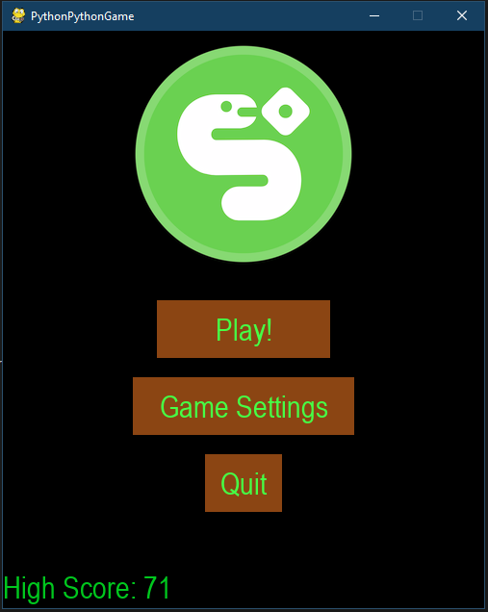
Abstract
Recreated the fun and simplicity of the classic snake game
Used Pygame framework in python
Added 2 player game modes and additional game setting
Focused on github, source control, teamwork and time management

Slide 3
Contributions

Slide 4
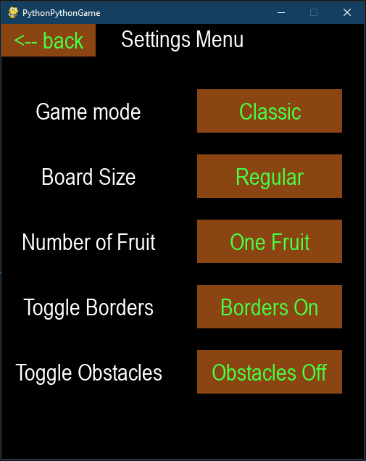
Aidan Zapotechne
Software
Settings menu (buttons and changing game settings based on button clicks)
2-P snake collision handling
Fruit spawns based on amount specified
2-P race timer
Obstacle implementation
Final Report
Abstract
Project Description
Professional Awareness

Slide 5
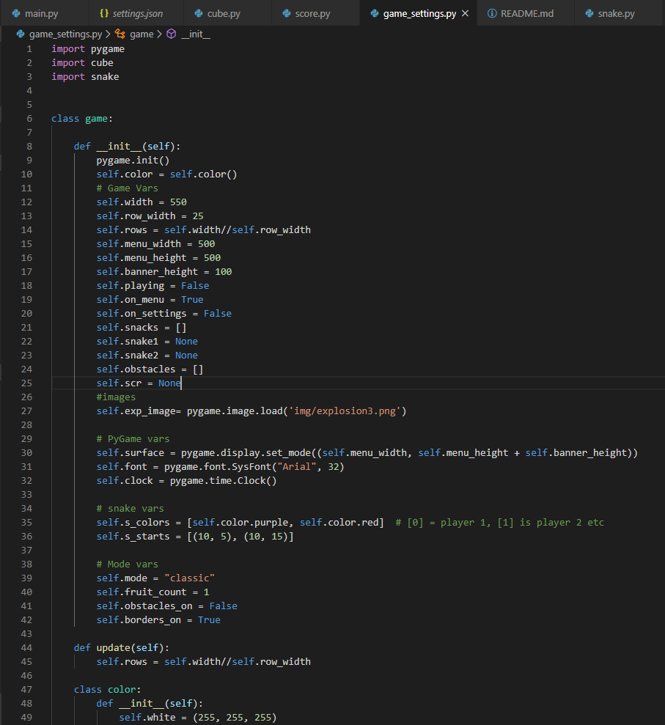
Derek Woods
Software:
Base Game (V1.0.0)
Simple framework of a single snake with movement, growth and collision detection to kickoff the project
Game Settings class
Various bug fixes and UI improvements
Final Report:
Game manual in ‘README.md’
Partial Objectives
Project Timelines

Slide 6
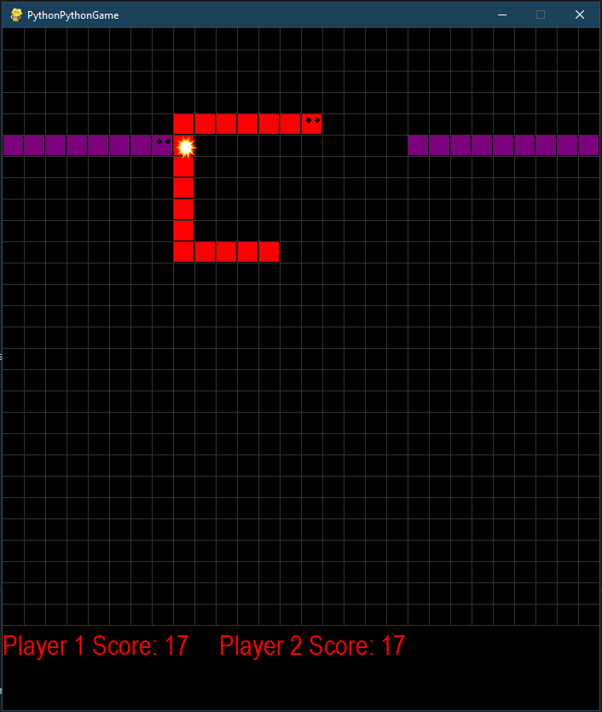
Toral Zaveri
Software:
Adding live score for classic game
Adding live score for 2-player
Final Report:
Conclusion

Slide 7
Project Objectives
Utilize the Pygame framework in Python to create an iteration of the snake game.
Have all the basic snake game aspects.
Make sure the game has an enjoyable user experience
Allow the difficulty to change during the game.
Follow engineering methodologies discussed in the course
Work effectively in a software engineering team

Slide 8
Project Description

Slide 9
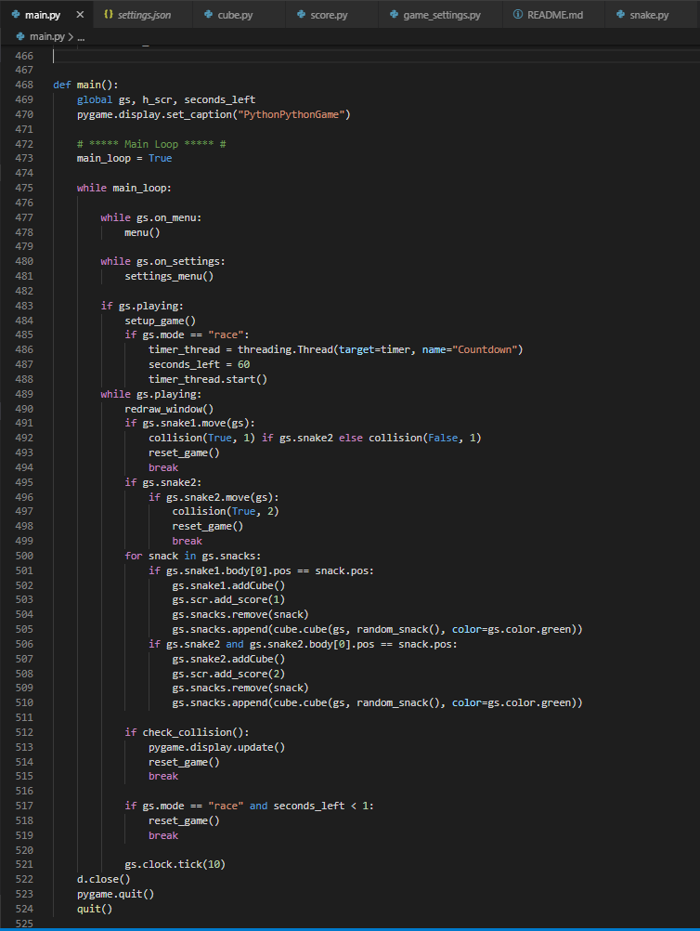
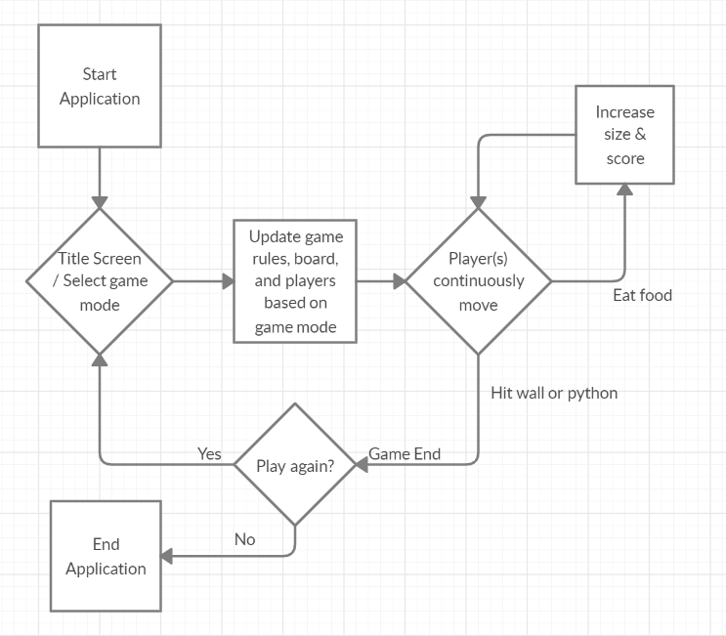
Software Design

Slide 10
Software Features
Several ways for the user to customize their experience via game settings
Main menu where player can start the game with default settings, or open the settings menu
In the settings menu the user can change five different attributes:
Gamemode - can be classic, two-player race, or two-player melee
Board size - player selects a range of five different boards that vary the amount of rows and columns traversable in game
Number of Fruit - player specifies how many fruits are spawned on screen at one time
Borders - player specifies if borders should either be obstacles, or pass through borders
Obstacles - user specifies if obstacles spawn, in which five grey tiles will spawn randomly on screen that the player must avoid

Slide 11
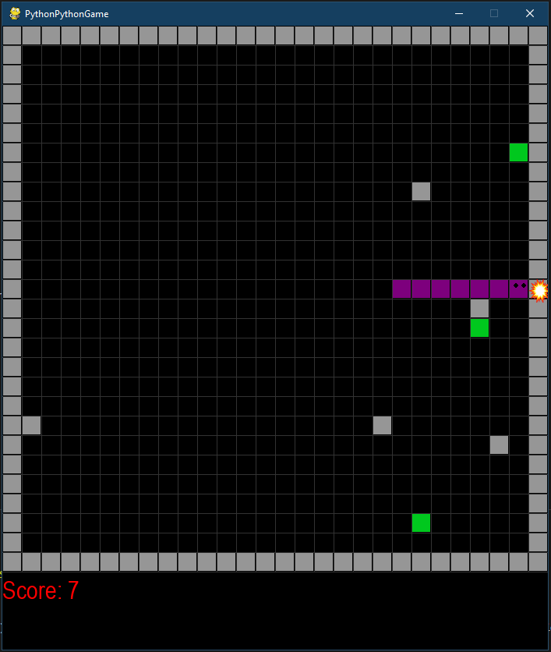
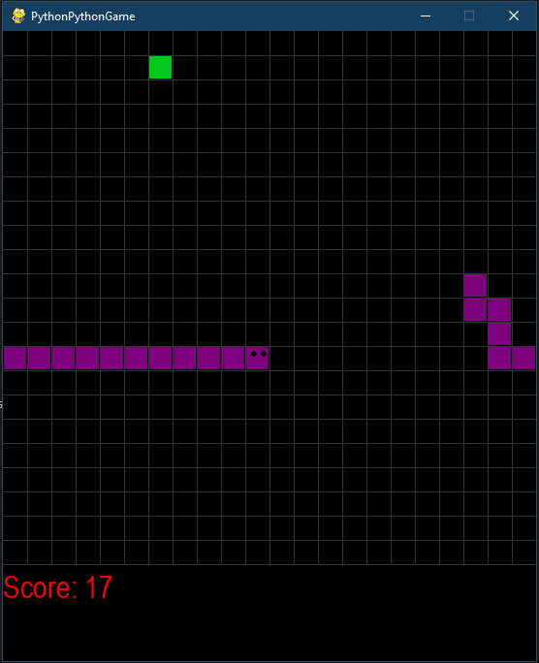
Single player
Classic
This is the only mode that supports high score
All settings can still be modified
Play until player crashes into obstacle

Slide 12
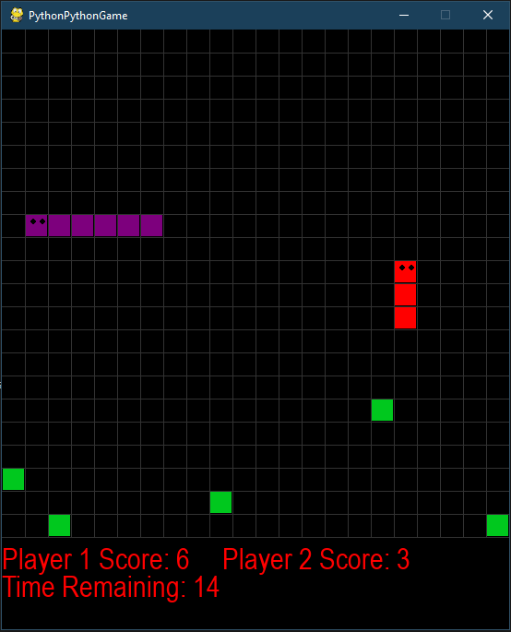
Two player
Race mode
60 second timer
Melee Mode
No fruits and growth every 10 moves

Slide 13
Project Difficulties and Solutions
How to implement snake movement, specifically the snake’s segments (long body) ?
How to implement different game modes?
How to maintain the high score?
Utilize python data structures in clever way: One list contains body segment positions and another contains the turns the snake takes
Two lists hold settings buttons, one is active settings and one is inactive. Based on which are pressed, the respective settings are updated
The high score is saved to the user’s local machine through the python shelve library

Slide 14
Project Timeline

Slide 15
Project Tasks
PyGame setup and draw game board were the first tasks completed.
Python sprite, user input, movement and food spawning were the next tasks tackled. The team was able to handle all collisions, growth, movement and rendering so the python was never transformed into a PyGame sprite.
After the base game was operational is when the menu was focused on. The menu was postponed until later since it was tied into the game settings, modes and UI improvements.
The final task was additional game modes and is where our team spent most of our time, additional game modes and settings required code refactoring and the gs object previously mentioned. The end result was the ability to add game features with ease.

Slide 16
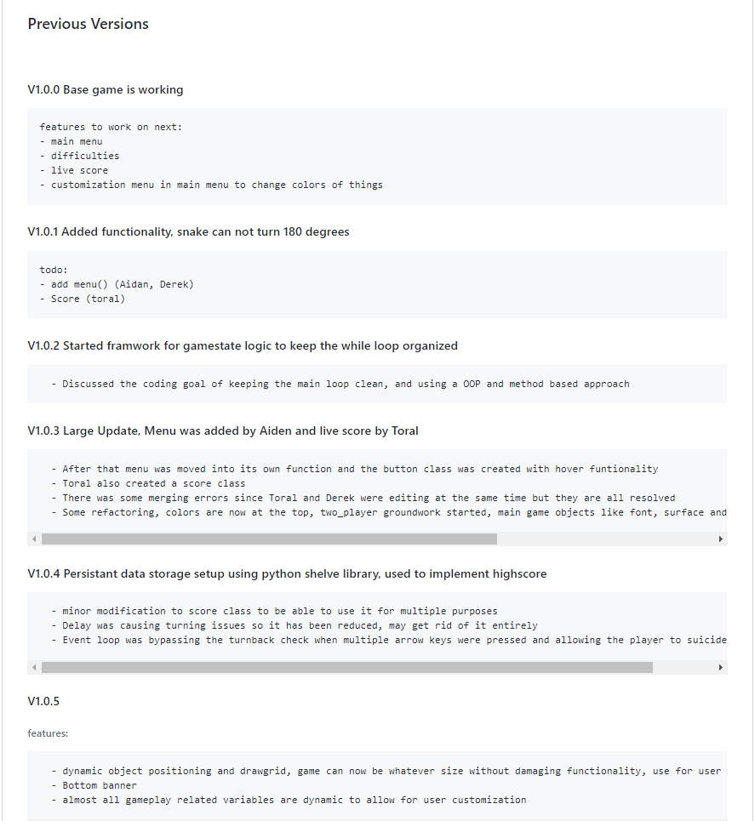
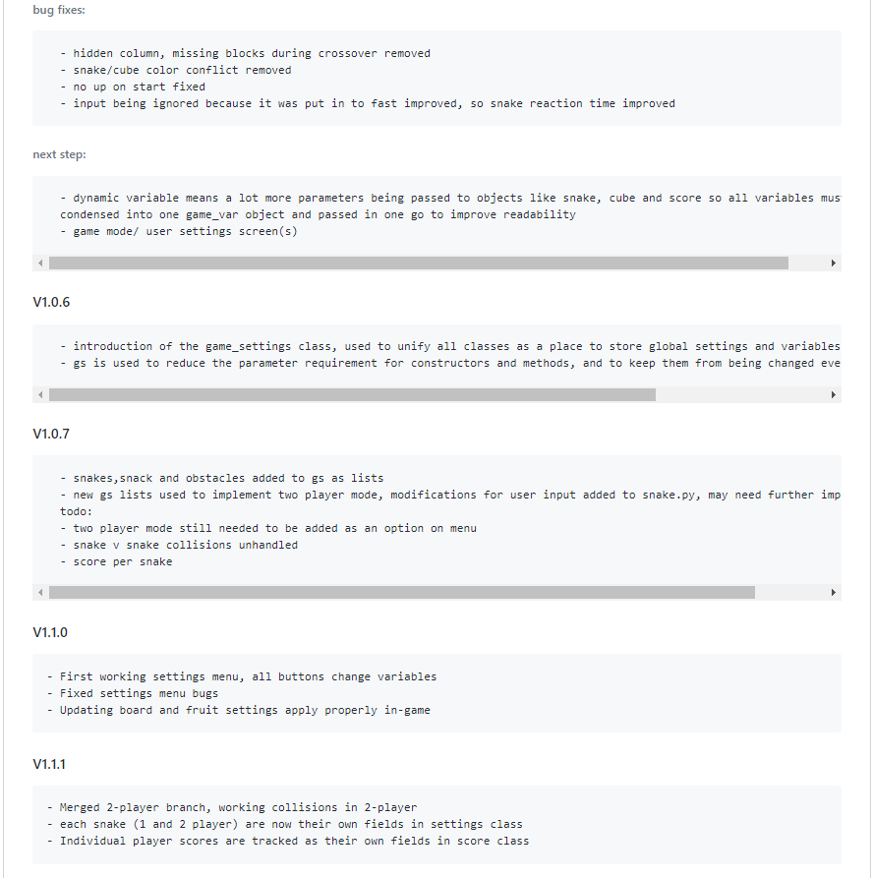
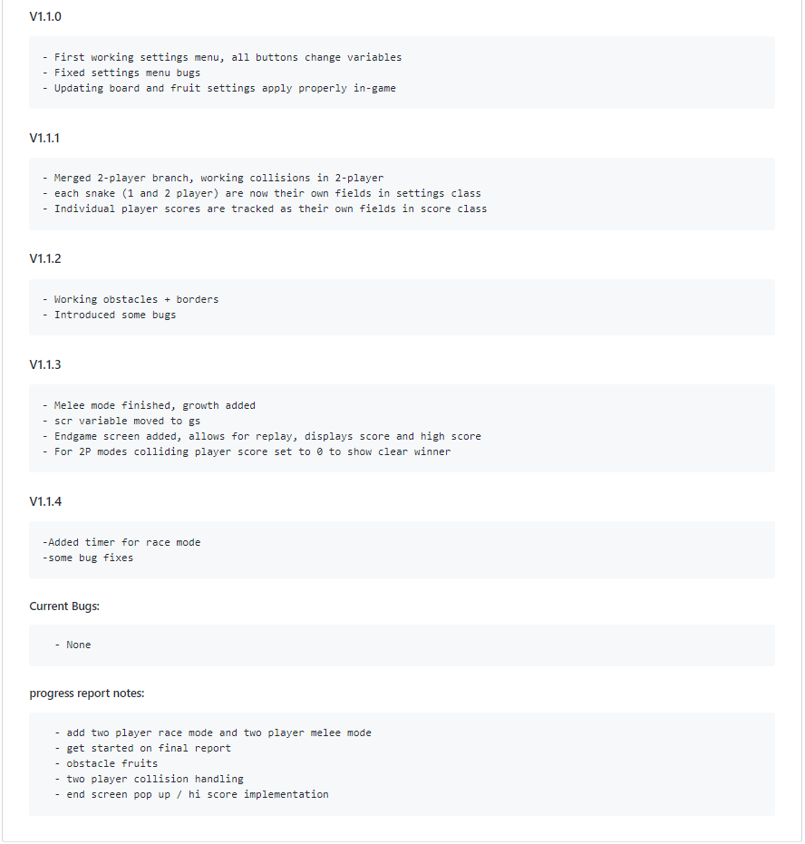
Version Control

Slide 17
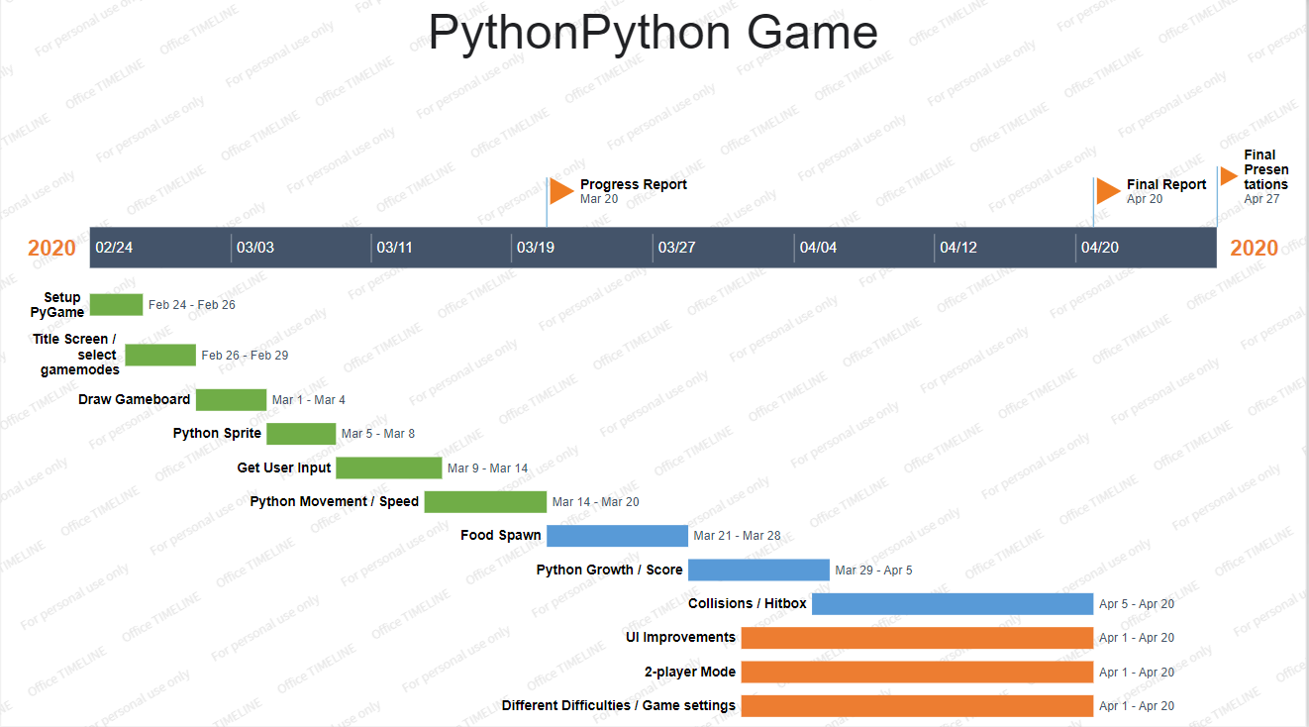
Gantt Chart:

Slide 18
Conclusion
For this project, we implemented a fully functional classic Snake game.
The newly unique version of the snake game has been created in Python.
By making this project, we learned a new framework, PyGame and learned how to work with the proper software engineering methodologies.
We faced many ups and downs while doing the project, but eventually we tested, fixed bugs, and updated our version of snake game.

Slide 19
References
“Pygame Front Page.” Pygame Front Page - Pygame v2.0.0.dev5 Documentation, www.pygame.org/docs/.
Sommerville, I. Software Engineering. 10th ed., Pearson/Addison-Wesley, 2004.
“Python 3.8.2rc2 Documentation.” 3.8.2rc2 Documentation, docs.python.org/3/.

